Slide 1


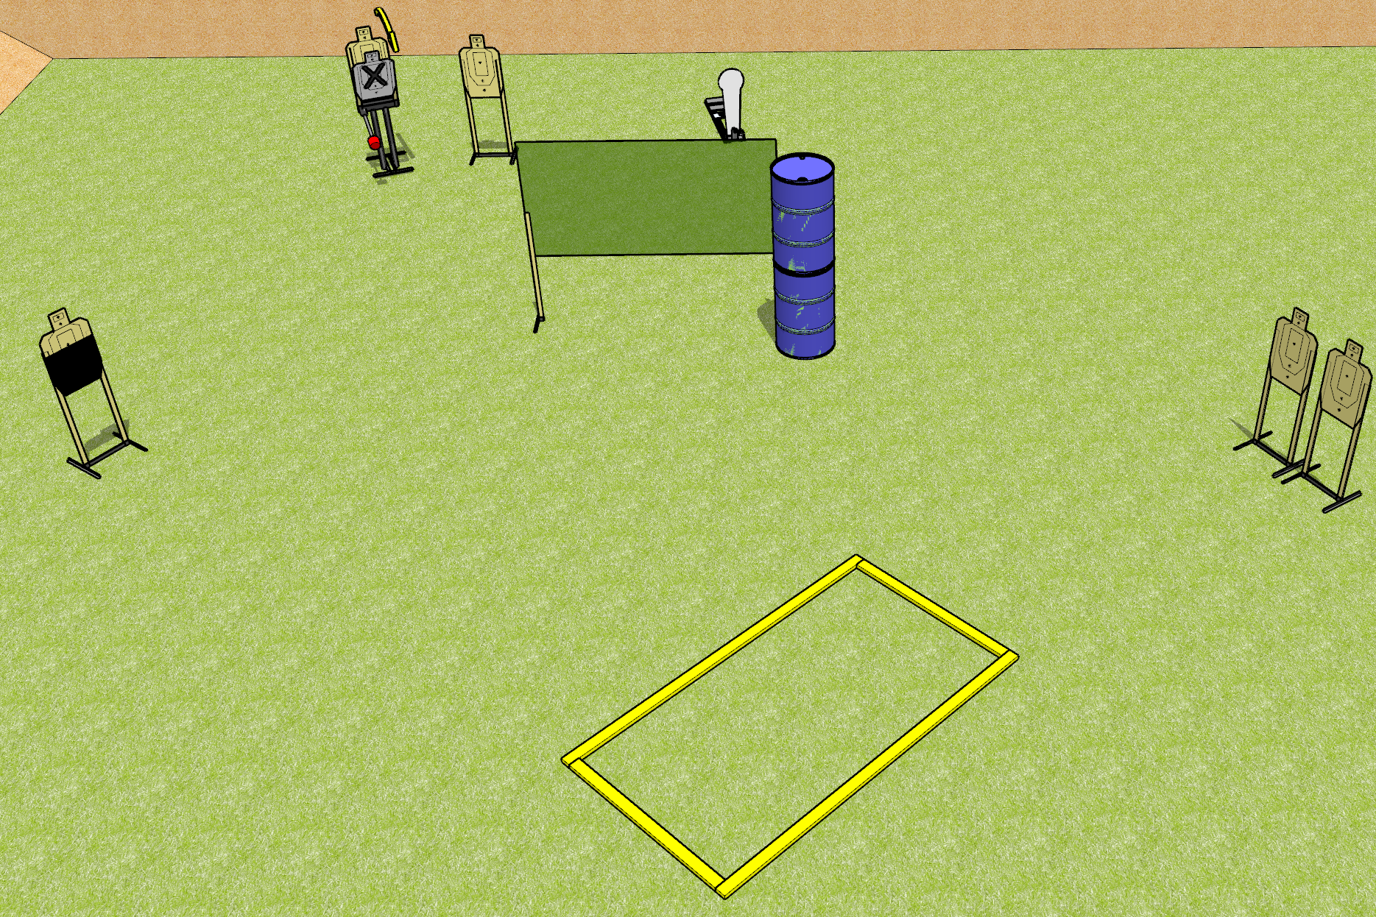
 | Dothan Gun Club – USPSA Match Easy Peasy Course Designer : Drew Coleman
Round Count 11 Rounds 5 USPSA 1 Colt popper
Equipment List 2 wall feet 2 medium fault lines + 2 10 ft fault lines Max trap + activator 1 50% HC

Slide 2
Easy Peasy
Written Stage Briefing
Easy Peasy is an 11 round, 55 point, Comstock course of fire. There are 5 USPSA targets and 1 colt popper. The best 2 hits on paper will score, and steel must fall to score. The start signal is audible.
The max trap is activated by the colt popper, and must be activated before being engaged. It is visible at rest.
Handgun start position is outside the shooting area, wrists below belt. Handgun is loaded and holstered,
PCC start position is outside the shooting area, stock on belt. Carbine is loaded with safety on.
On start signal engage targets as they become available from within the shooting area.

Slide 3
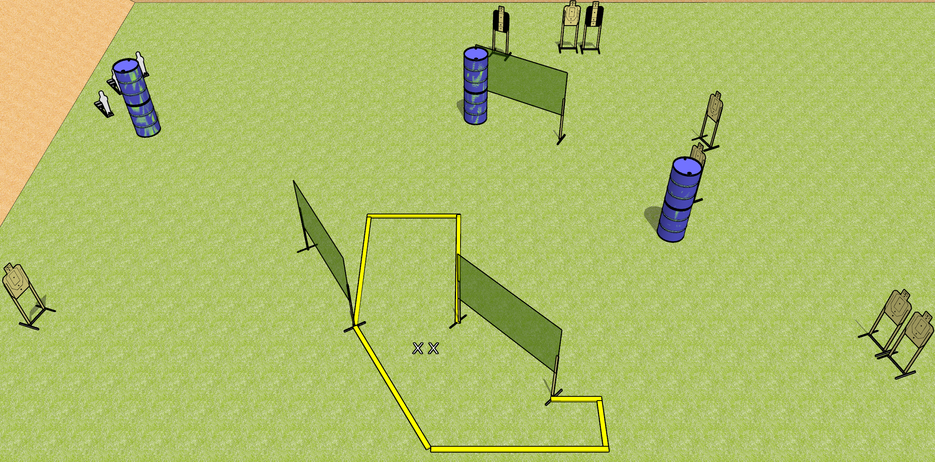
 | Dothan Gun Club – USPSA Match Diving About Course Designer : Drew Coleman
Round Count 19 rounds 8 USPSA targets 3 mini poppers
Equipment List 6 wall feet 3 medium fault lines 2 tuxedos

Slide 4
Diving About
Written Stage Briefing
Diving About is a 19 round, 95 point, Comstock course of fire. There are 8 USPSA targets and 3 mini poppers. The best 2 hits on paper will score and steel must fall to score. The start signal is audible.
Handgun start position is both feet on X’s, wrists below belt. Handgun is loaded and holstered.
PCC start position is both feet on X’s, stock on belt. Carbine is loaded with safety on.
On start signal, engage targets as they become available from within the shooting area.

Slide 5
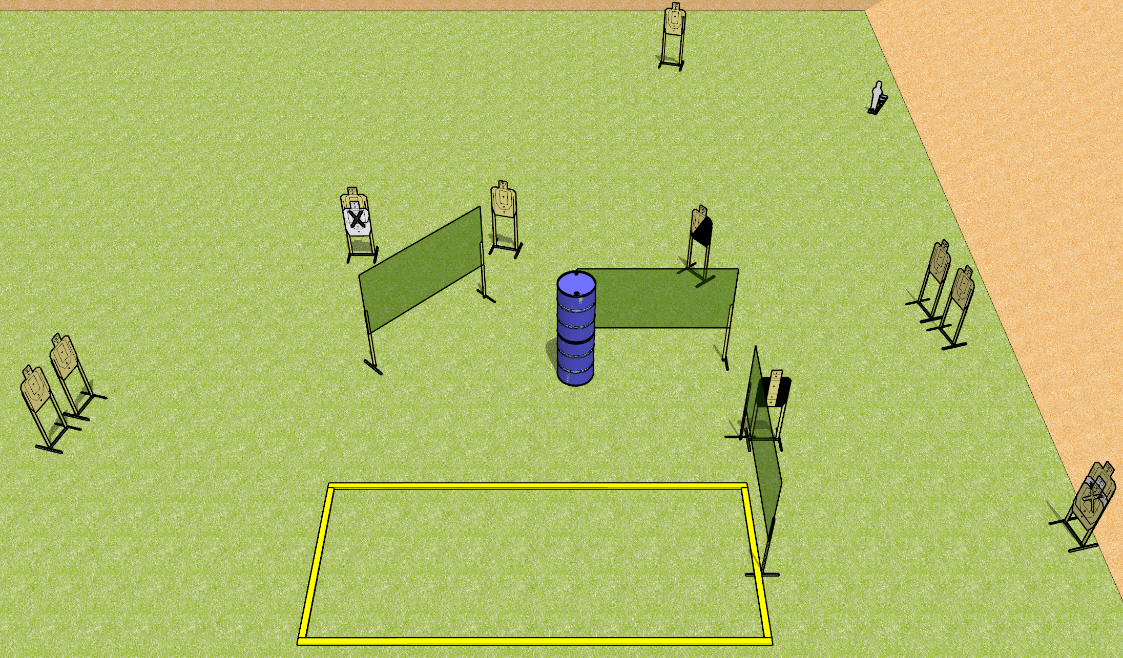
 | Dothan Gun Club – USPSA Match All Around Course Designer : Drew Coleman
Round Count 23 rounds 11 USPSA targets 1 mini popper
Equipment List 6 Wall feet Make shooting area 20x8 1 diagonal HC, 1 tuxedo Far right target is stacked with NS

Slide 6
All Around
Written Stage Briefing
All Around is a 23 round, 115 point, Comstock course of fire. There are 11 USPSA targets and 1 mini popper. The best 2 hits on paper will score, and steel must fall to score. The start signal is audible.
Handgun start position is inside the shooting area, wrists below belt. Handgun is UNLOADED and holstered.
PCC start position is inside the shooting area, stock on belt. Carbine is UNLOADED.
On start signal, engage targets as they become available from within the shooting area.

Slide 7
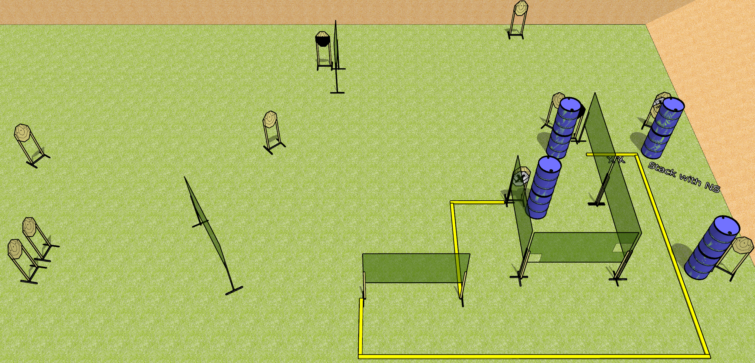
 | Dothan Gun Club – USPSA Match I Like Turtles Course Designer : Drew Coleman
Round Count 24 rounds 12 IPSC
Equipment List 9 wall feet 3 medium fault lines 1 upper third HC, 1 tuxedo

Slide 8
I Like Turtles
Written Stage Briefing
I Like Turtles is a 24 round, 120 point, Comstock course of fire. There are 12 IPSC targets. The best 2 hits on paper will score. The start signal is audible.
Handgun start position is both feet on X’s, facing uprange, wrists above shoulders. Handgun is loaded and holstered.
PCC start position is both feet on X’s, stock on belt. Carbine is loaded with safety on.
On start signal, engage targets as they become available from within the shooting area.

